Slide 1

UNIVERSITÀ DEGLI STUDI DI SALERNO
Dipartimento di Informatica
Corso di Laurea Magistrale in Software Engineering and IT Management
Student Riccardo Imparato 0522501613
Professor Dario Di Nucci
ACADEMIC YEAR 2023/2024

Slide 2
Goal
The goal was to fork a project and to use various tools for the software testing.

Slide 3











What was used
GitHub
IntelliJ IDEA
SonarCloud
Codecov
JaCoCo
PiTest
Java Microbench Harness
Evosuite
Randoop
FindSecBugs
OWASP DC

Slide 4
Forking
The project has been forked with GutHub, and then cloned with IntelliJ IDEA.

Slide 5
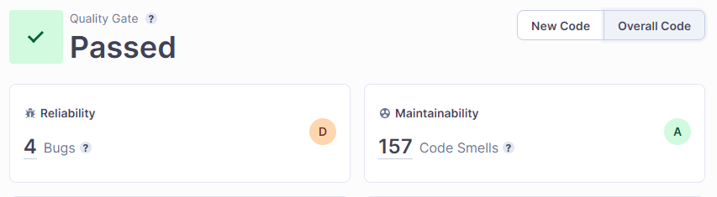
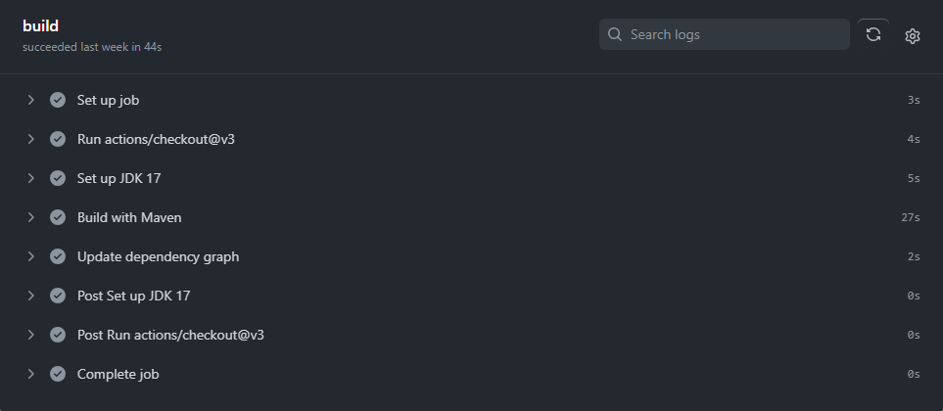
Building and bug fixing
The project was builded, bug fixed with the support of SonarCloud, and at last, builded with GitHub actions.

Slide 6
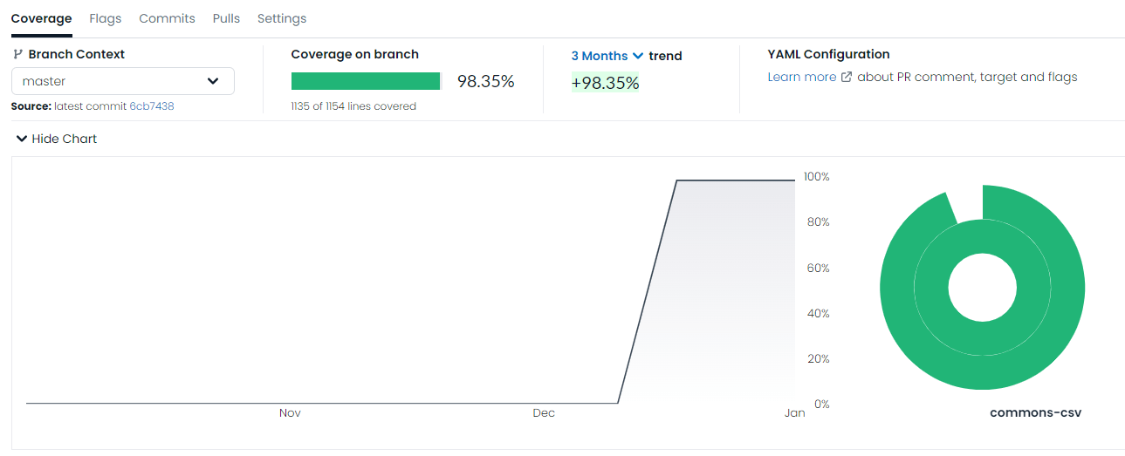
Code coverage
JaCoCo has been used to create the coverage report, and sent the results to the site Codecov.

Slide 7
Mutation and performance testing
The mutation test was done with PiTest. It created 709 mutations, of which 677 (95%) were killed.
Instead, the performance testing was done with Java Microbenchmark Harness. This testing was done in order to compare different functions performing the same task.
Benchmark | Mode | Cnt | Score | Error | Units
CSVBenchmark.parseCommonsCSV | avgt | 20 | 3359,297 | ± 21,839 | ms/op
CSVBenchmark.parseGenJavaCSV | avgt | 20 | 3035,217 | ± 6,604 | ms/op
CSVBenchmark.parseJavaCSV | avgt | 20 | 1280,663 | ± 33,184 | ms/op
CSVBenchmark.parseOpenCSV | avgt | 20 | 1521,555 | ± 37,987 | ms/op
CSVBenchmark.parseSkifeCSV | avgt | 20 | 2080,360 | ± 45,026 | ms/op
CSVBenchmark.parseSuperCSV | avgt | 20 | 1712,673 | ± 37,787 | ms/op
CSVBenchmark.read | avgt | 20 | 198,199 | ± 4,087 | ms/op
CSVBenchmark.scan | avgt | 20 | 1158,116 | ± 31,365 | ms/op
CSVBenchmark.split | avgt | 20 | 971,231 | ± 23,498 | ms/op

Slide 8
Automated testing
The automated tests were done with EvoSuite and Randoop.
Randoop generated 6 regression tests while EvoSuite made a report about the main classes.
TARGET_CLASS | criterion | Coverage | Total_Goals | Covered_Goals
org.apache.commons.csv.Constants | * | 0,0 | 2 | 0
org.apache.commons.csv.CSVFormat | * | 0,830 | 3668 | 2788
org.apache.commons.csv.CSVParser | * | 0,643 | 746 | 388
org.apache.commons.csv.CSVPrinter | * | 0,703 | 351 | 224
org.apache.commons.csv.CSVRecord | * | 0,743 | 315 | 205
org.apache.commons.csv.DuplicateHeaderMode | * | 1,0 | 0 | 0
org.apache.commons.csv.ExtendedBufferedReader | * | 0,838 | 649 | 496
org.apache.commons.csv.Lexer | * | 0,709 | 1075 | 569
org.apache.commons.csv.QuoteMode | * | 1,0 | 0 | 0
org.apache.commons.csv.Token | * | 0,917 | 29 | 27
*the criterion is: LINE;BRANCH;EXCEPTION;WEAKMUTATION;OUTPUT;METHOD;METHODNOEXCEPTION;CBRANCH

Slide 9
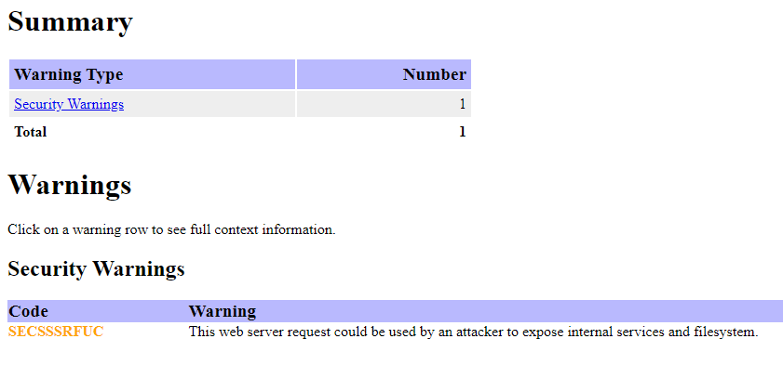
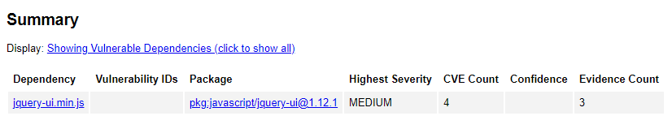
Security testing
The security tests were done with FindSecBugs and OWASP DC.
FindSecBugs gave just 1 security warning in the report.
OWASP DC, instead, found 4 medium vulnerabilities.

Slide 10
Thank you for your attention!

